Slide 1

Ergonomics Semester 2 Week 6

Slide 2
What had been discussed last week
Design the algorithm to handle moment of inertia, angular acceleration, and linear acceleration
Keep looking for available dataset with 3D ground truth and video data

Slide 3
Timeline
Content | Date | Progress
Learning Basics of Deep Learning | Sep 2022 | Done
Installing Alphapose/Openpose/VideoPose3D | Sep-Oct 2022 | Done
Learning Ergonomics Basics | Oct-Nov 2022 | Done
Forming a Framework of Time Continuous Cumulative Fatigue
Preparing for Final Exam | Nov-Dec 2022 | Done
Review the Time Continuous Cumulative Fatigue Framework | Dec 2022 | Done
Trying to Extract Coordinates Using Alphapose/Openpose | Dec 2022
Adding on a Cumulative Fatigue Assessment using Alphapose/Openpose with Python | Jan-Mar 2023
Writing a Technical Report for our Research | April 2023

Slide 4
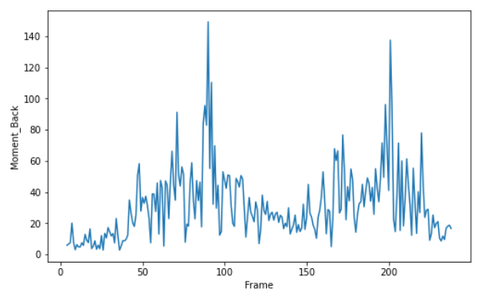
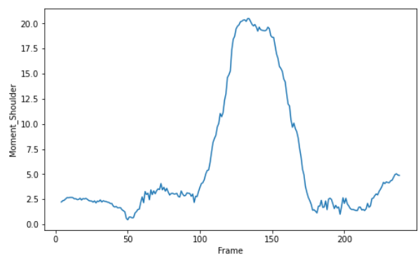
Result of Moment
Moment about Low Back
Moment about Shoulder

Slide 5
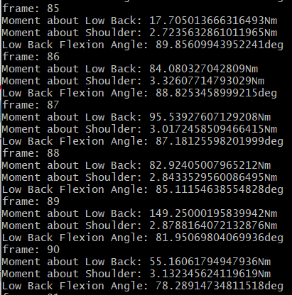
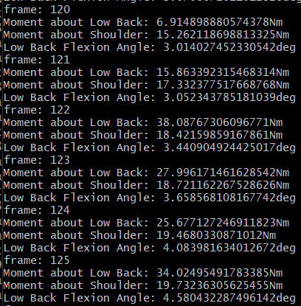
Result of Moment

Slide 6
Challenges of This Week
The moment is not real value, it will change according to the frame per second
There’s lot of noise in the moment results

Slide 7
Next Meeting
Try 5 frames per 5 frames and observe whether the noise is lesser
Design an algorithm to calculate stress

